Slide 1
Making IATI Work at the Country Level
October 2017

Slide 2
UNICEF Experience
Overall goal
Build on existing aid data platforms (AIMS/AMPs and UNICEF-IATI) to improve aid transparency and coordination through automating aid data reporting between the governments and development partners
Approach
‘Phase III’ for UNICEF’s transparency efforts: Data use
Pilot countries: Madagascar and Senegal
Expectations
Analysis of IATI data published by UNICEF
Demonstrate the value of publishing data in the IATI standard
Capacity building - Aid Management Fellows working with government counterparts and UNICEF staff
Notes:
UNICEF
Goals: Transparency and accountability is a top priority for UNICEF in delivering development and humanitarian results for children. The aim was to build on existing platforms (AIMS/AMPs and UNICEF data published in IATI) to improve aid transparency and coordination through automating aid data flow between the governments and development partners (such as UNICEF)
Approach: Madagascar and Senegal - these two countries were selected as they already shown advancement and understanding in aid transparency and IATI
Expectations and Results:
Documentation of process, lessons learned (challenges) useful for UNICEF
What are the missing links between the national government funding and implementation data sets with that of UNICEF
To achieve reporting automation and simplification through IATI-AIMS
Possibility to share with the IATI community for other organizations to scale up (aid traceability)
Gain understanding at the country level UNICEF data made available to the public
Establish a common understanding within the UN Country Teams, and in relation to the host government on programme and financial reporting data sources and requirements
Advocacy: Demonstrate the value of publishing aid data in the IATI Standard
better data quality, timeliness, depth
possibility to reduce data reporting burden (government partners and donors)
possibility to use IATI data at the national level and programme improvements to serve the country needs
Coordination with national governments, UN country teams and other stakeholders on use of consistent and up-to-date data (efficiency gains for shifting time spent on manual reporting for greater programme impact) common framework/understanding
UNICEF offices identify own data gaps in country programmes

Slide 3
Goals
Demonstrate value of IATI for efficient reporting.
Improve UNICEF IATI data to better serve partner country needs.
Test embedded IATI Fellows approach.
Create knowledge products and guidance on IATI data use.
Notes:
UNICEF

Slide 4
Process
Critical for Country Office, Government, and HQ Office to all work together to understand various data sources
In-depth understanding of IATI needed by all parties
Time investment needed to understand, improve, and prepare data

Slide 5
IATI and AMP-Madagascar
All Projects funded by External donors, inc.
DPs,
INGOs,
Foundations,
Decentralized Cooperations
AMP
IATI Workspace
IATI Registry: imported into AMP-MDG via the import Tool

Slide 6
AMP DATA VS IATI DATA
Global data
AMP-Madagascar contains data from 2009 (Based on government and local DPs official decision)
IATI Madagascar registry includes data from 1977
Data | IATI (since 1977) | AMP (since 2009)
Number of records | 2 985 | 1 513
Number of DPs | 54 | 111
Number of bilateral DPs | 26 | 19
Number of multilateral DPs | 16 | 28
Number of NGOs and others | 12 | 64
PTF present in IATI but not directly in AMP | 30
PTF present in AMP but not in IATI |  | 87

Slide 7
MAIN IMPORT RESULTS IN AMP-MADAGASCAR
24 DPs have been imported
8 Bilaterals (including two new actors: Sweden et DFID)
12 Multilaterals (including one new actor: UN-Habitat)
4 International NGOs and others
791 imported projects/programs
About 27% of data linked to MDGs have also been imported.

Slide 8
ADDED VALUE OF THE IMPORT TOOL
With IATI, the team was able to collect information of partners that were not present in AMP (Sweden, DFID, Fairfood, etc.).
The team was also able to collect a certain level of details on financial transactions as well as additional data for a few (USA et UNICEF) - this level of detail was not present in AMP

Slide 9
IATI DATA VS AMP DATA
Data since 2009
Records
Data type | IATI (since 2009) | AMP (since 2009)
Number of records | 1 588 | 1 513
Total commitments (in USD) | 7,8 Billions USD | 5,9 Billions USD
Total disbursments (in USD) | 5,5 Billions USD | 4,2 Billions USD
 | IATI | AMP
Record type | Reporting by organization | Check of duplicates and co-funding
UNICEF example | 119 activities Expenditures from 2009 - 2016: 240 millions USD | 13 components based on results Disbursments 2009-2016: 248 millions USD

Slide 10
IATI IMPORT PROCEES IN AMP-MADAGASCAR
Download the file for the IATI website
Launch the import tool in AMP
Upload the IATI file
Filter data
Choose projects
Choose project fields
Perform mapping
Review and import data

Slide 11
DOWNLOAD THE IATI FILE - UNICEF EXAMPLE

Slide 12
LAUNCH THE AMP IATI IMPORT TOOL AND CHOOSE THE FILE VERSION

Slide 13
UPLOAD THE FILE

Slide 14
FILTER DATA

Slide 15
CHOOSE PROJECTS

Slide 16
CHOOSE THE FIELDS
Map IATI fields to AMP fields

Slide 17
MAPPING
Make a values correspondence between the AMP fields and the IATI fields

Slide 18
REVIEW AND IMPORT

Slide 19
MAIN IMPORT RESULTS
75 % UNICEF Madagascar activities are imported in AMP-Madagascar

Slide 20
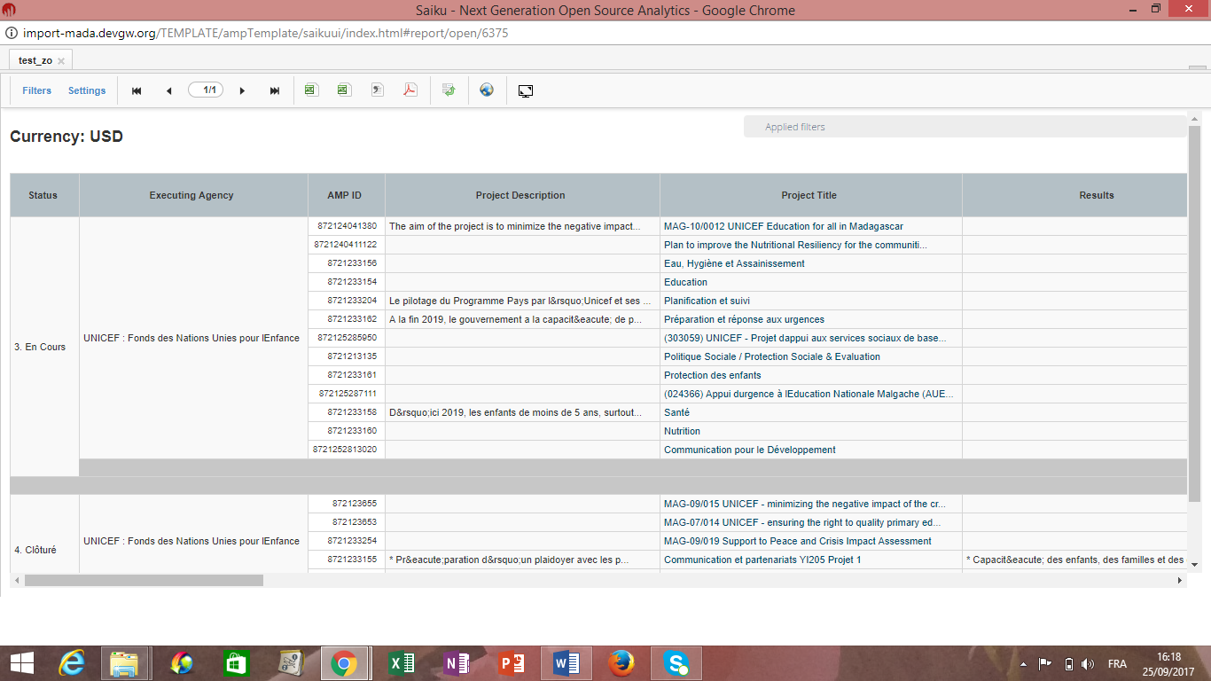
Experience with UNICEF

Slide 21
Experience with UNICEF
Better data:
In terms of content
1) Harmonized figure published for UNICEF MADAGASCAR.
Additional important information:
Intersectoral Activities
Cross-sectoral activities
2) More reliable data:
Apart from quality control made by AMP team, as part of the process and before importing the data, data quality control and structure is made before importing IATI data

Slide 22
Key Takeaways
Feedback on the process and how to scale it out:
Given the analysis of DPs IATI data structure file already made, generalization of the process
and extension of the operation to other organizations is possible
Scaling up plan is ongoing and starting with AfDB, UNDP and USAID, ToR already established and contact made
Recommendations:
Given the context of decentralization, an increasing level of fund are now invested at regional level
That data can be coupled with funding location at regional level,

Slide 23
Questions?
Timothy Takona | ttakona@unicef.org
Harpinder Collacott | harpinder.collacott@devinit.org
Josh Powell | jpowell@developmentgateway.org
Isaora Zefania Romalahy | rmizef@gmail.com

Slide 24
Improvements to the IATI-AIMS Import Tool
Importing transactions by Provider Organization
Mapping IATI description to multiple fields in AIMS
Allowing IATI field to map to multiple fields in AIMS, ex. Sector to Sector and National Plan.
Add import of IATI Results fields
Add policy marker to import
Expanding AMP dates you can map to
General improvements: extending timeout value, improving error messages, etc.

Slide 25
Senegal Achievements
Import of UNICEF IATI data: 32 projects
Definition of common structure mapping from UNICEF’s results-based IATI reporting to AMP schema
Government comfort level with IATI increased, with ambition to scale to other funders
UNICEF country office staff also trained on IATI data
Included analysis and comparison of internal UNICEF data systems with IATI data

Slide 26
Key Insights
Start by creating definition guides between internal organization’s systems, IATI, and AIMS
Understand reporting roles and responsibilities for multi-donor funded projects to AIMS
Understand reporting levels and how data is reported to AIMS.
If Administrative Costs should be included or not
Disbursements should be reported as individual transactions, not an aggregated sum.
Locations and funding
On/Off Budget
Reporting Timeline
Data improvements through feedback from users to publishers

Slide 27
Start by creating definition guides between internal organization’s systems, IATI, and AIMS
Understand reporting roles and responsibilities for multi-donor funded projects to AIMS
Understand reporting levels and how data is reported to AIMS.
Disbursements should be reported as individual transactions, not an aggregated sum.
Locations and sub-national funding are important
On/Off Budget is critical
Data improvements through feedback from users to publishers
Key Takeaways

