Slide 1
IFAD’s Progress in the transparency agenda: steps ahead
IATI Members’ Assembly
3 – 5 October 2017
Ursula Wieland
Programming and Resource Analyst (OPE)

Slide 2
Transparency: why and for whom?
Accountability
Beneficiaries
Decision making
WHY
Quality of data
FOR WHOM
Member states
Partners
Risk management
IFAD
Transparency is a transformational force
2

Slide 3
Transparency: where?
Info to GBs
Operations
Financial resources
WHERE
Operations
Management of financial resources and internal oversight
HR
Management of human resources
Considerable more weight will be given, organization-wide, to transparency
Information to governing bodies
3

Slide 4
Transparency in Operations: how?
IATI
International Aid Transparency Initiative
IATI standard
Borrower information
Reporting to Governing bodies
Project information:
Geographical location
Project completion reports
External auditor’s reports
Accessible website
HOW
Disclosure
Access to operational data
Corporate reports on performance & results of IFAD-supported operations
Responses to the beneficiary client surveys
Policies, data and procedures will support the transparency agenda
4

Slide 5
Transparency in Operations: IATI
Compliance with the IATI standards
Now
Near future
Manual
Annually
Aggregated disbursements
Automated
Monthly
Disaggregated transactions
Project documents
Project area location
Manual
Annually
Aggregated disbursements
Further phase
Results data
Reliable data are at the basis of transparency
5

Slide 6
Embracing transparency in everything we do
Accountability
Beneficiaries
Decision making
WHY
Quality of data
Partners
FOR WHOM
Member states
Risk management
IATI
International Aid Transparency Initiative
Info to GBs
IFAD
Financial resources
WHERE
Operations
Accessible website
HOW
Disclosure
Ultimate objective
HR
Access to operational data
facilitate a results culture
6

Slide 7
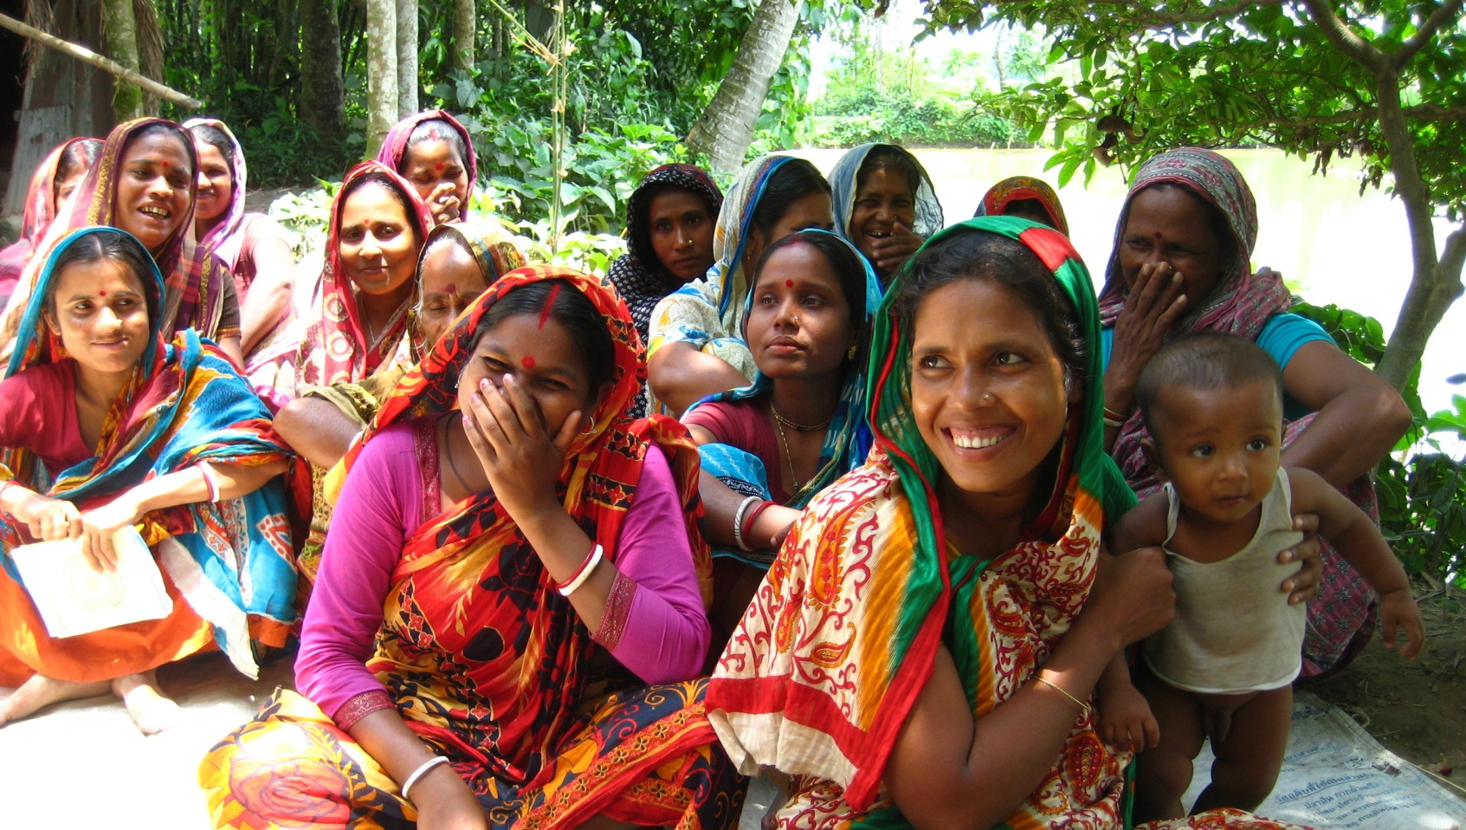
Thank you for your attention

